Slide 1
Predictors of mental health illness
Ronit Kumar
Tejveer Singh

Slide 2
introduction
This is a simple supervised learning model trained on Open Source Mental Illness dataset from a 2014 survey that measures attitudes towards mental health and frequency of mental health disorders in the tech workplace.
Can we predict whether a patient will seek treatment of his/her mental illness or not according to the values obtained in the dataset?

Slide 3
Library and data loading
The project has been implemented using python machine learning libraries:
Linear Algebra - NumPy
Data Processing - Pandas
Visualization - Matplotlib, Seaborn
Computing – SciPy
Algorithms - sklearn.
Input File – CSV [survey.csv]

Slide 4
Data cleaning
Dealing with Missing Data
Get rid of the variables like "Timestamp", “comments”, “state” because they are not really useful to our study.
Cleaning NaN. Replacing it with either a default value or with the mean of all the values seen so far. We coerced values for missing data fields.
Split the data into clearly identifiable classes. The original data had many discrepancies that were cleaned or removed.
For example, A lot of people left out the self-employed field. So it was marked NaN. It was changed to not self employed.

Slide 5
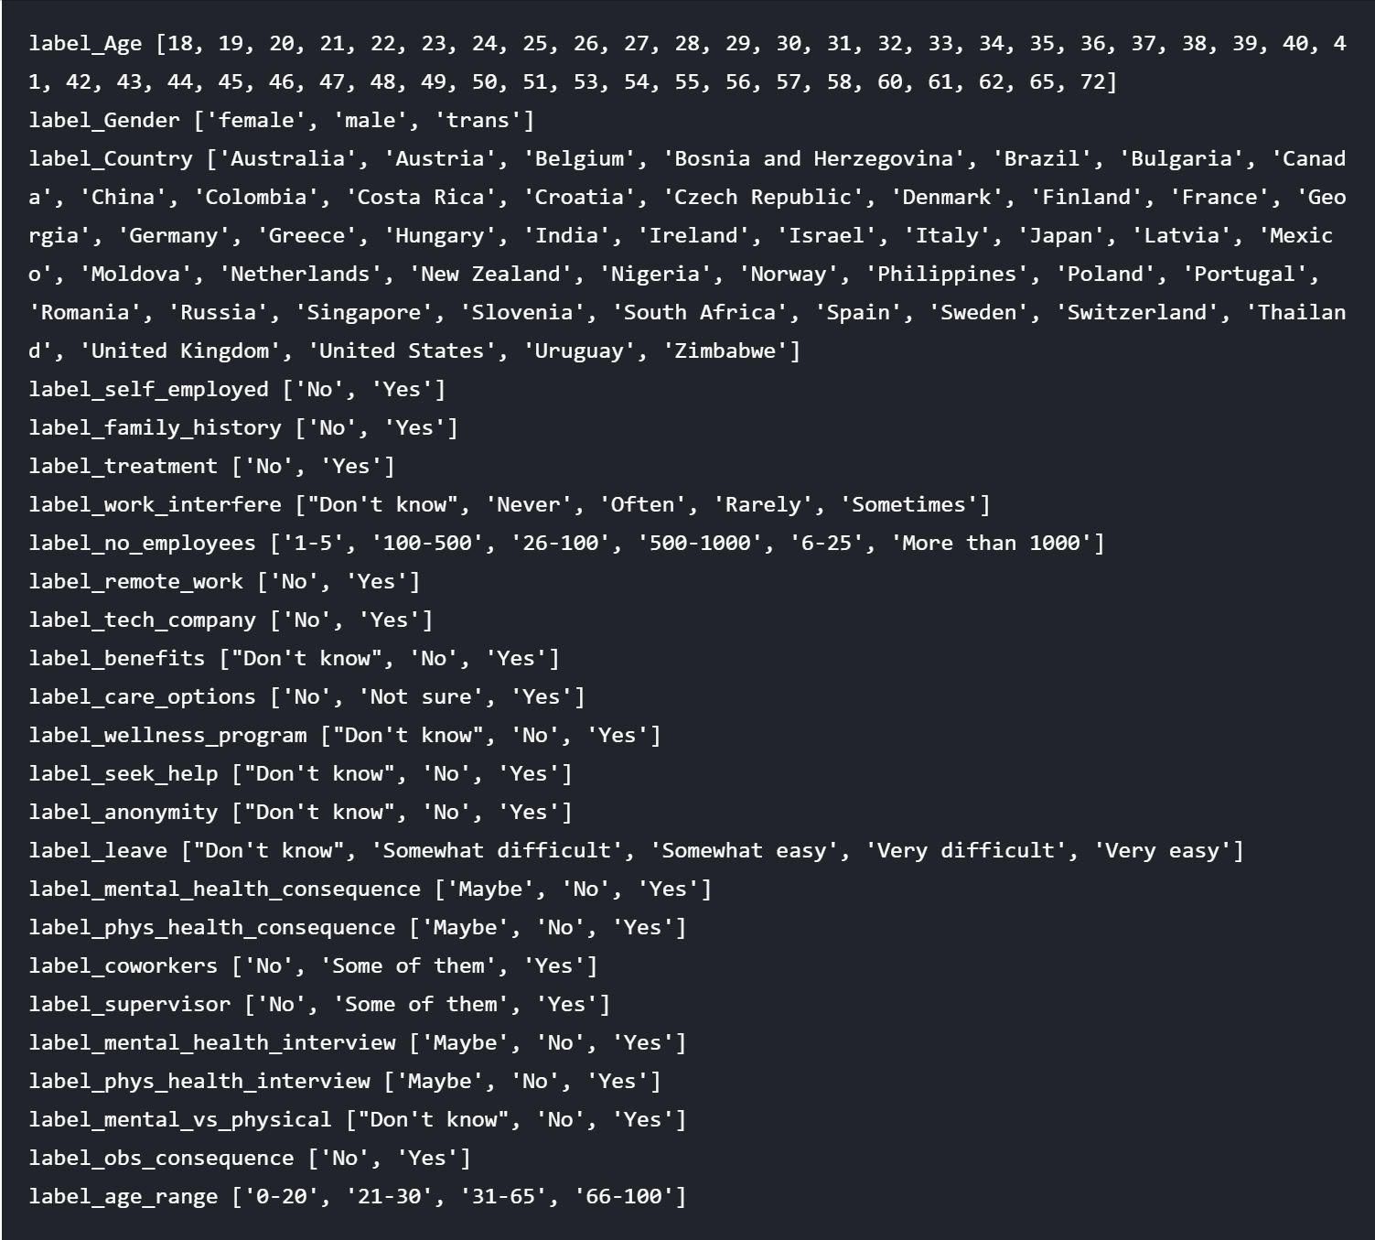
Encoding data
Dividing data into clearly identifiable labels.
The data labels will be used for parameter tuning.
We will see in the next slides how these labels will be used for exploratory data analysis.

Slide 6

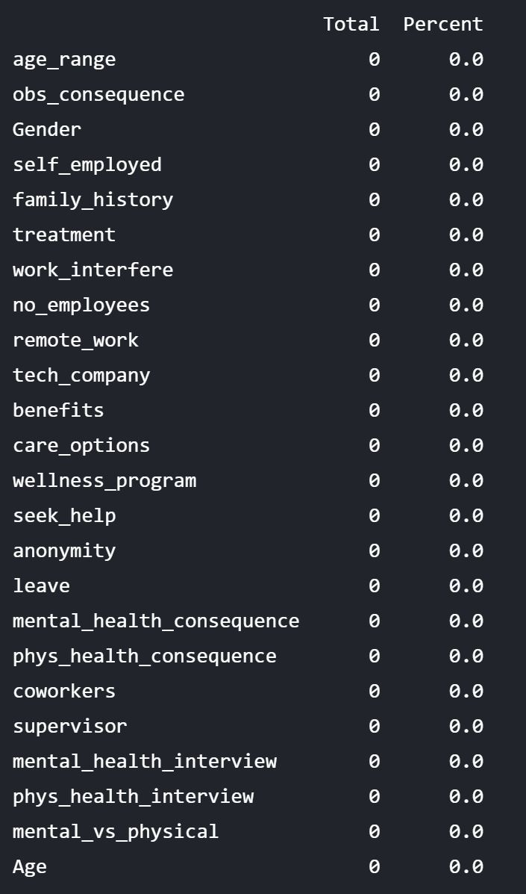

Testing
We use a simple sum function over the Boolean isNull?. We divide it by 100 to see what percentage of data is missing.
Our data has been cleaned of all discrepancies which can be seen here.

Slide 7
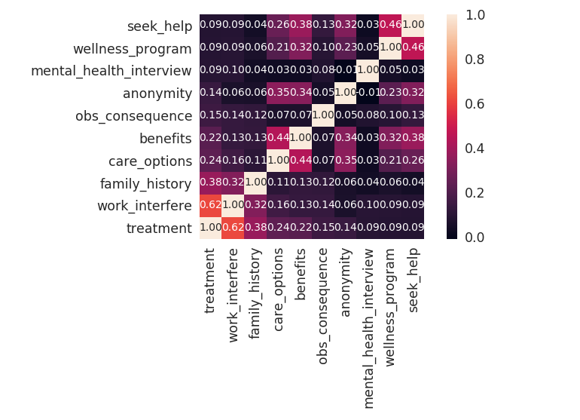
Covariance Matrix
Variability comparison between categories of variables.
We see that some parameters like anonymity, care_options are more co-related.

Slide 8


charts to see data relationship

Slide 9
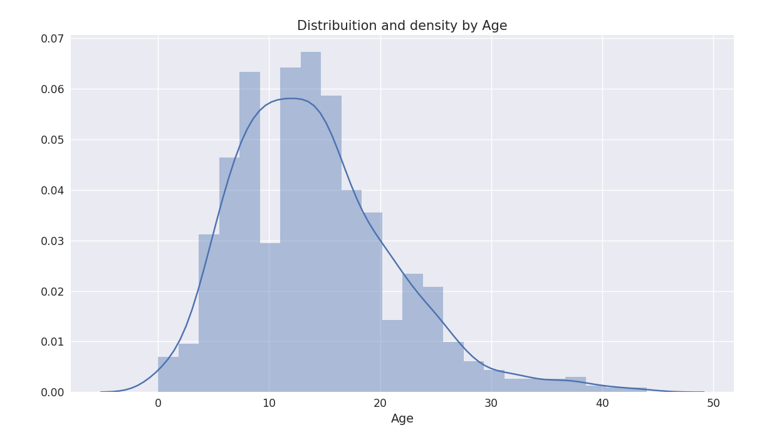
Distribution and density by Age

Slide 10
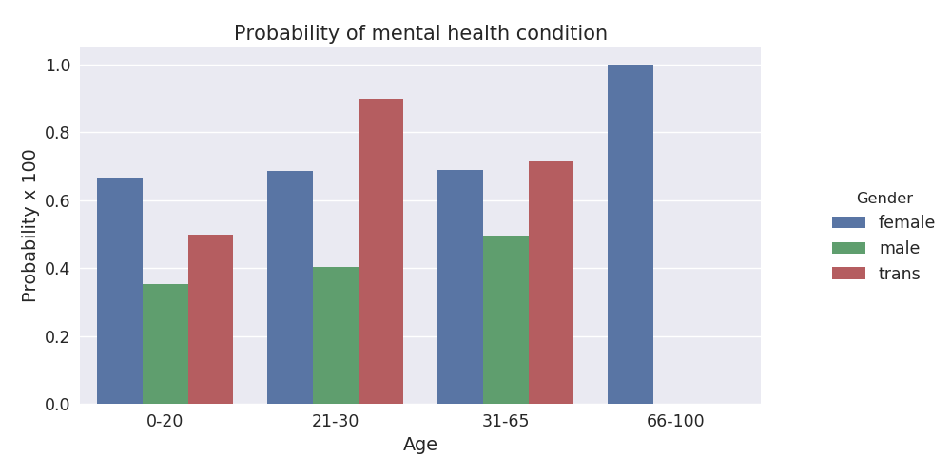
probabilities w.r.t Age

Slide 11
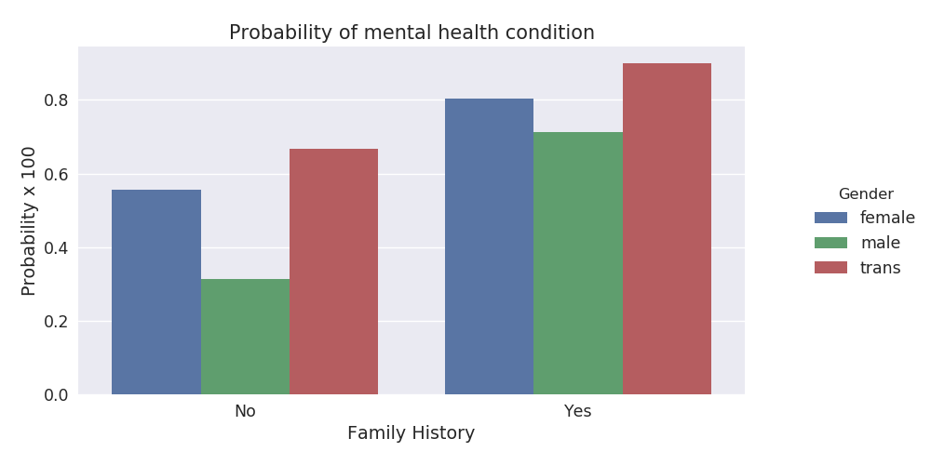
probabilities w.r.t Family History

Slide 12
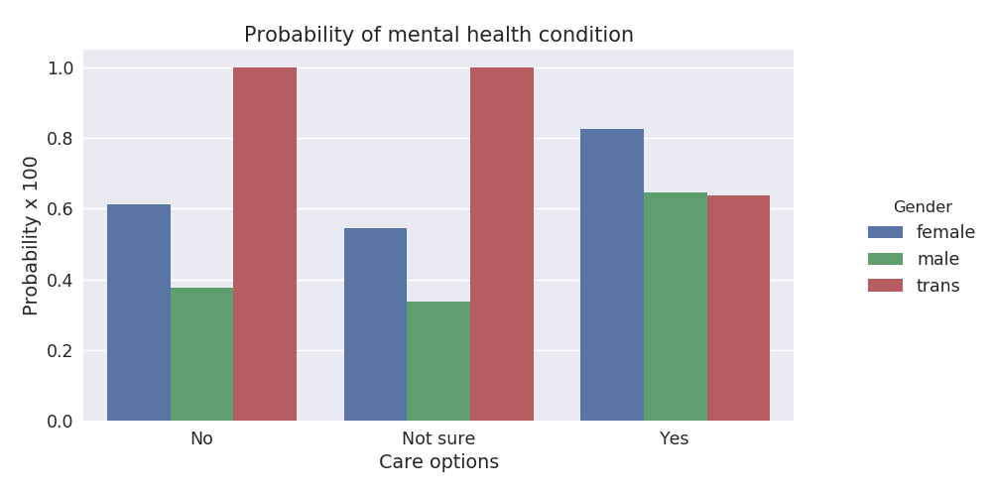
probabilities w.r.t care options

Slide 13
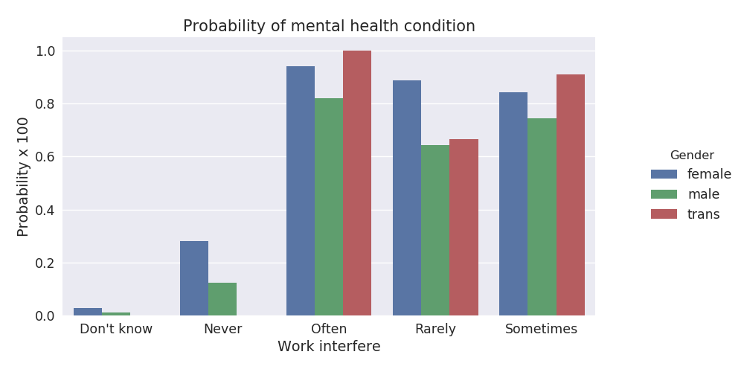
probabilities w.r.t Mental health interfering with work

Slide 14
Scaling and fitting
We're going to scale age, because is extremely different from the other ones.
Scaling with age also gives us a nice overview of the distribution of mental health problems across age groups.
Build a forest and compute the feature importance. This gives us a nice overview of our most important features that influence our results the most.

Slide 15
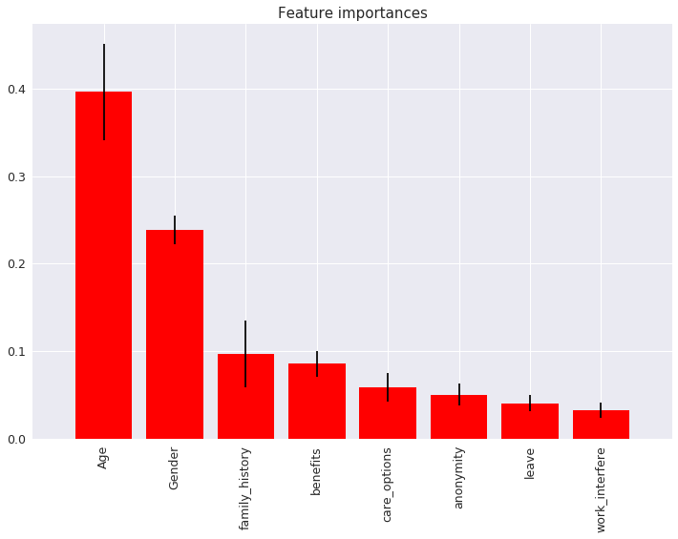
Important features
We see that age, gender and family_history are some of the factors that influence our result the most.
We also see that people think that having a mental condition does not interfere with their work at all. [Maybe work is the problem?]

Slide 16
Tuning
Evaluating a Classification Model
Classification accuracy: percentage of correct predictions across the results we have.
Null accuracy: accuracy that could be achieved by always predicting the most frequent class.
Confusion matrix: Table that describes the performance of a classification model and how correctly it is classifying results.
AUC: Area under the curve is the percentage of the Rate of Change plot.

Slide 17
Evaluating models
Logistic Regression
KNeighborsClassifier function
Decision Tree classifier function
Random Forests function
Bagging function
Stacking function

Slide 18
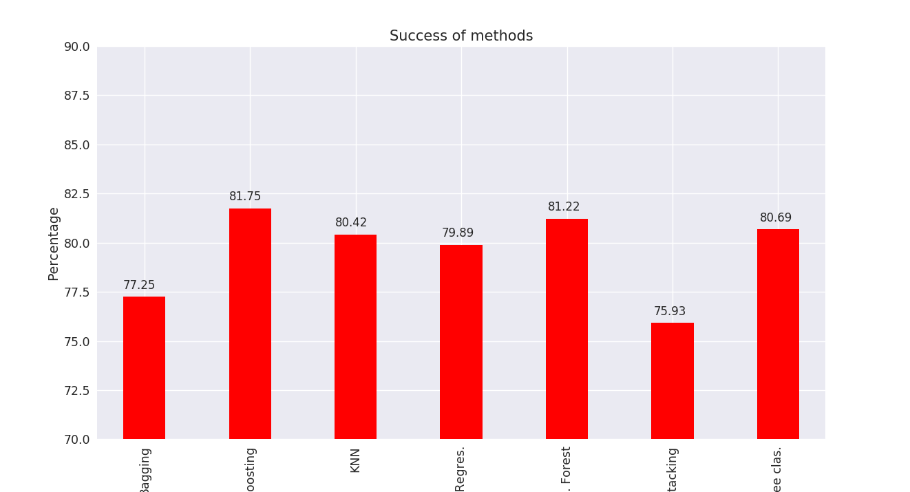
Success method plot

Slide 19
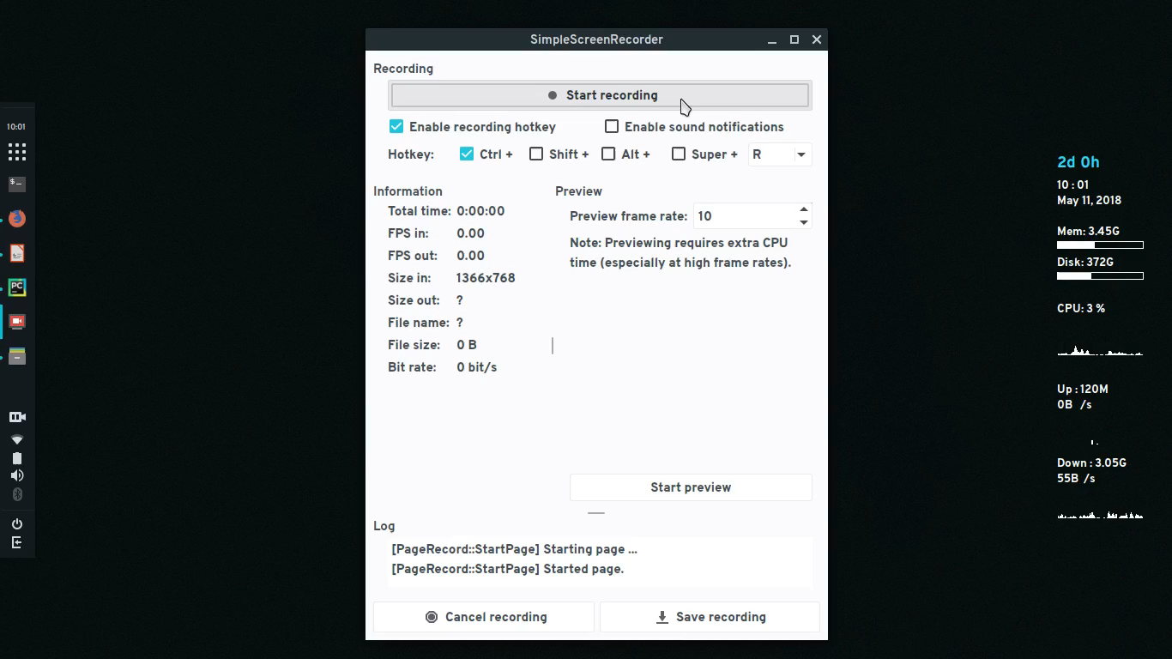

Slide 20
Conclusions
As a beginner we don't know whether the results are the best. We think over 80% of success in the majority of methods is a good rate, but we got our doubts.
We see that women are at higher risk to mental health issues, but find it harder to communicate their issues.
People working at tech companies are more open to discussing mental health issues than people working in other industries.

Slide 21
References
https://www.kaggle.com/kairosart/machine-learning-for-mental-health/data
http://scikit-learn.org/stable/modules/grid_search.html
https://machinelearningmastery.com/bagging-and-random-forest-ensemble-algorithms-for-machine-learning/
https://en.wikipedia.org/wiki/Logistic_regression
DataCamp

Slide 22



